Slide 1
UNIT-2
KNOWLEDGE REPRESENTATION

Slide 2
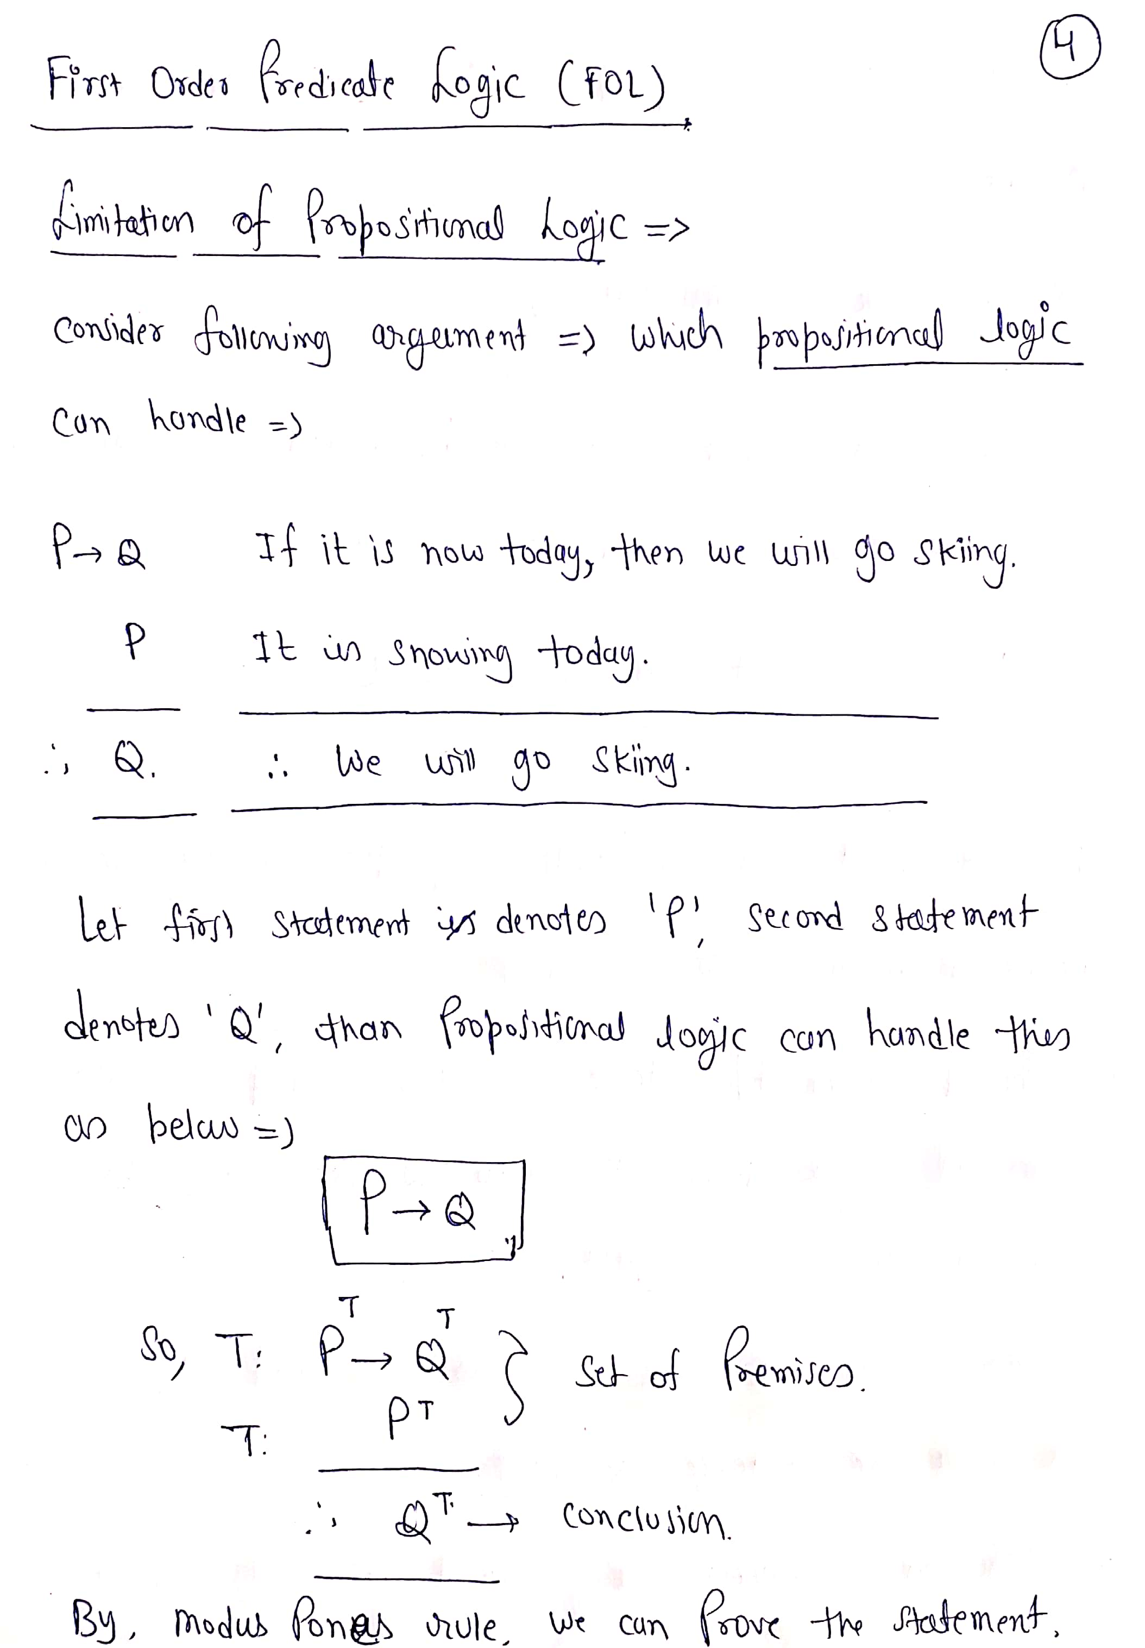

Slide 3
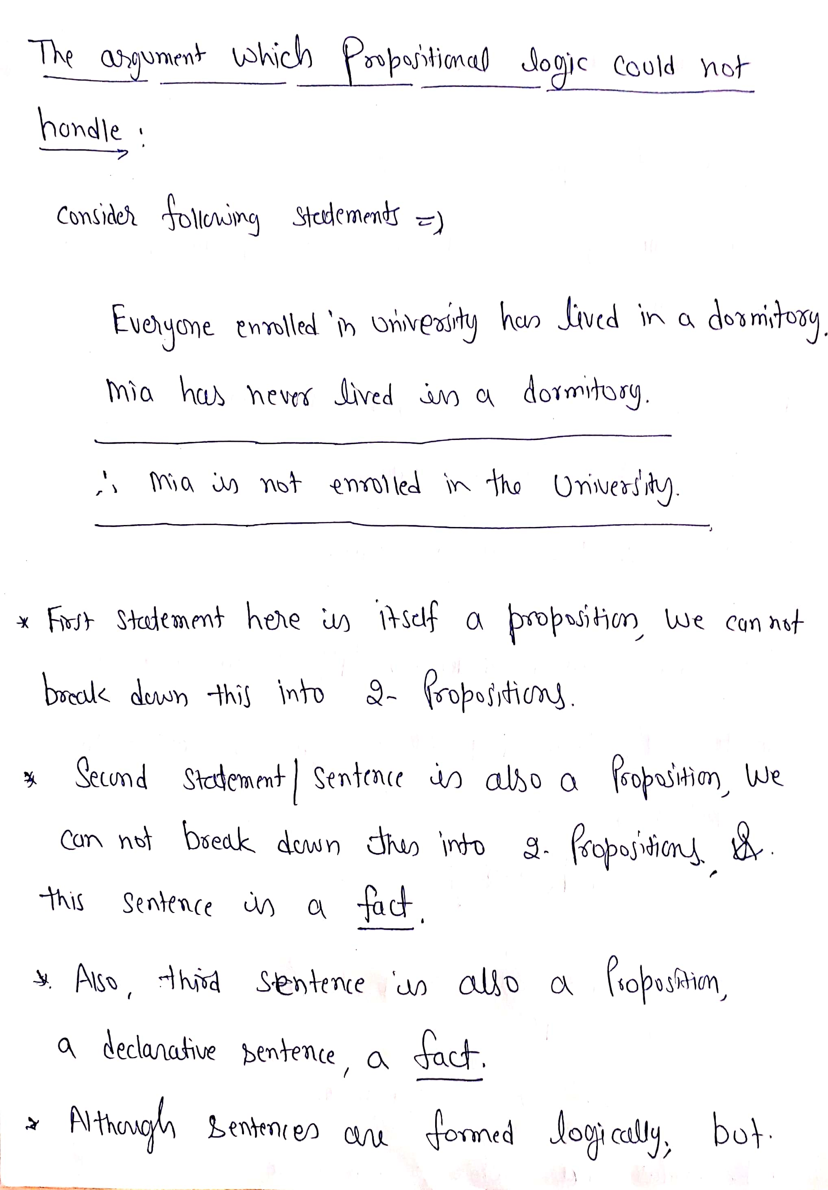

Slide 4
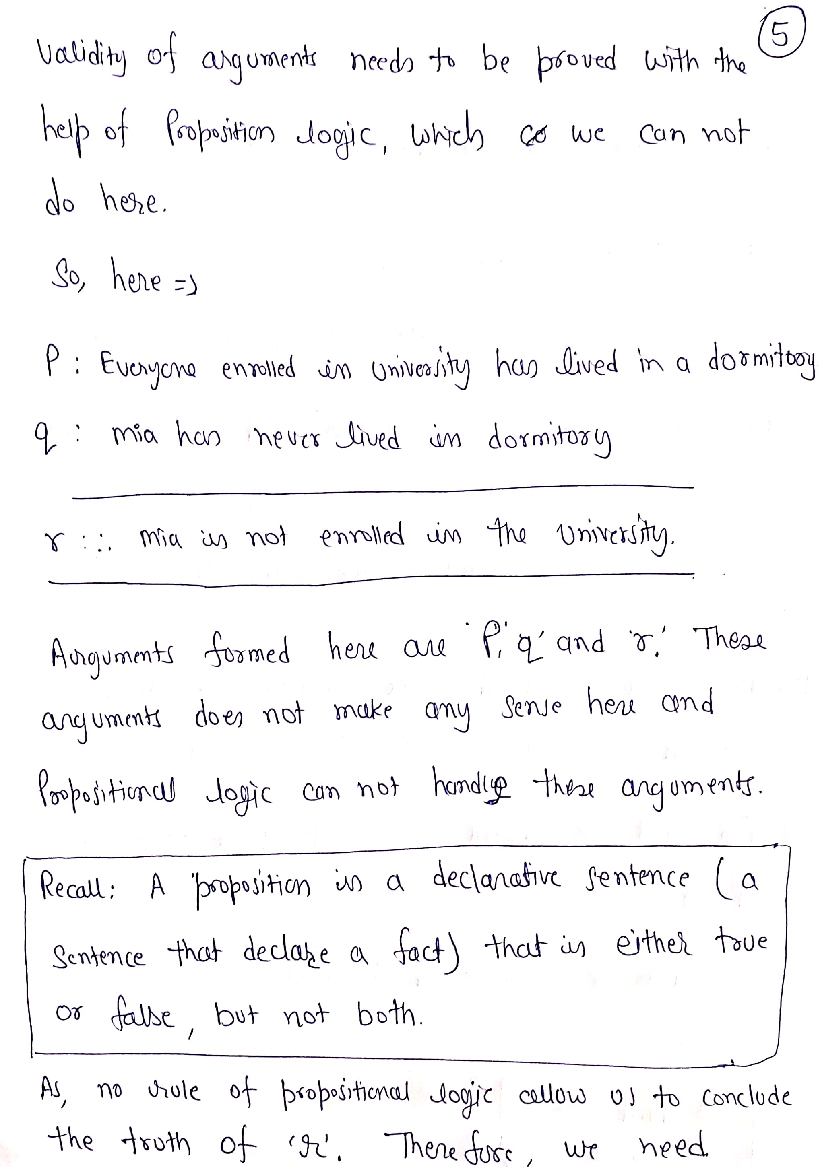

Slide 5
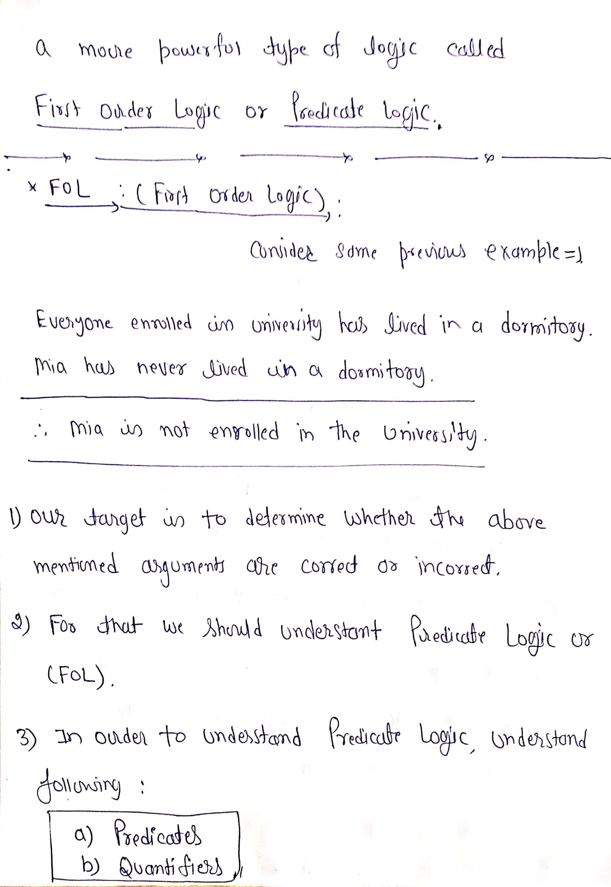

Slide 6
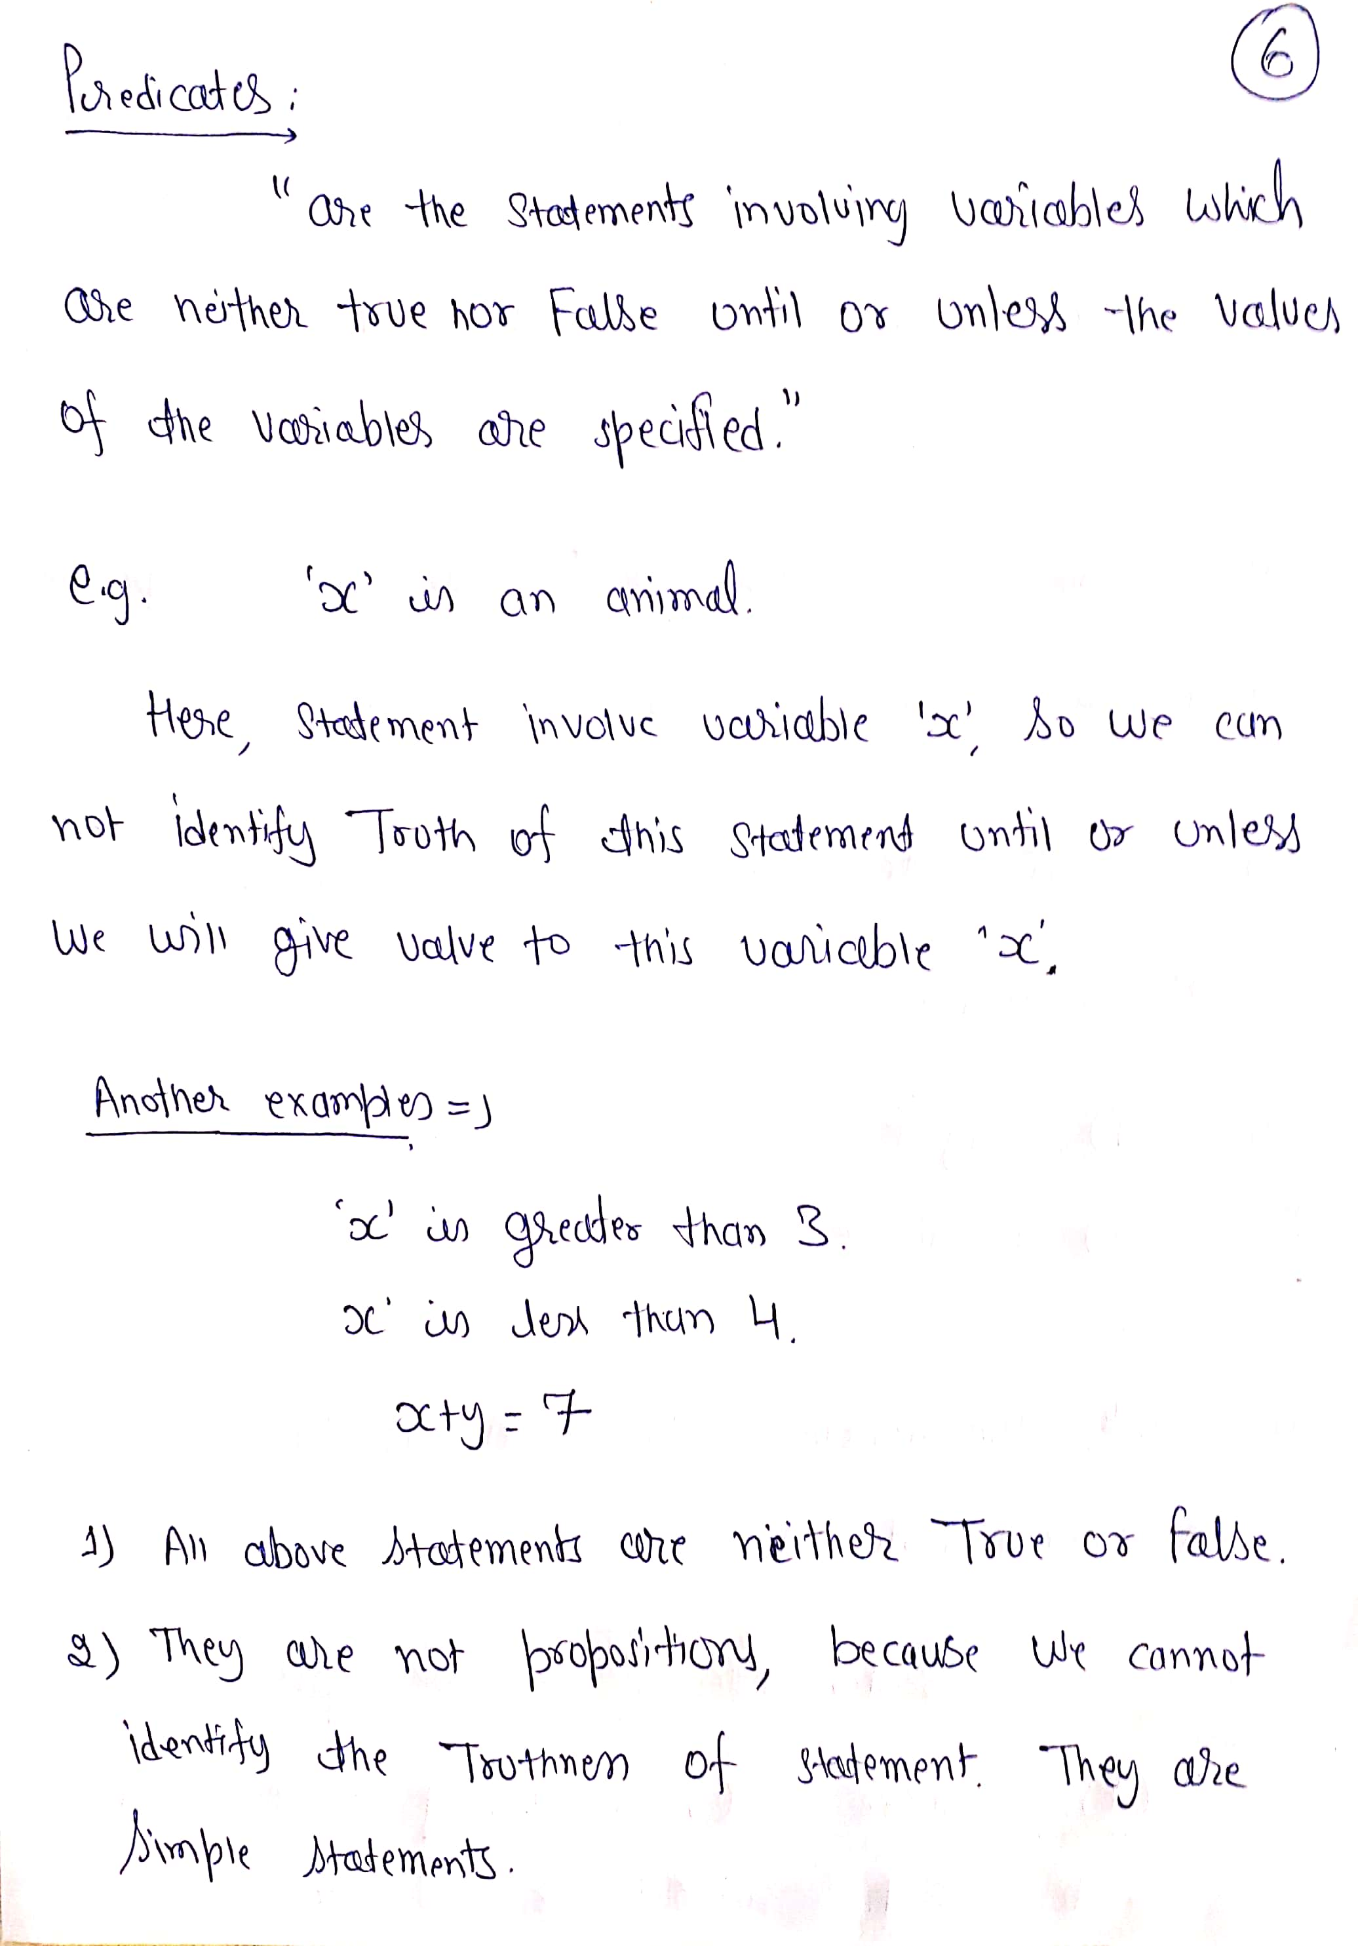

Slide 7
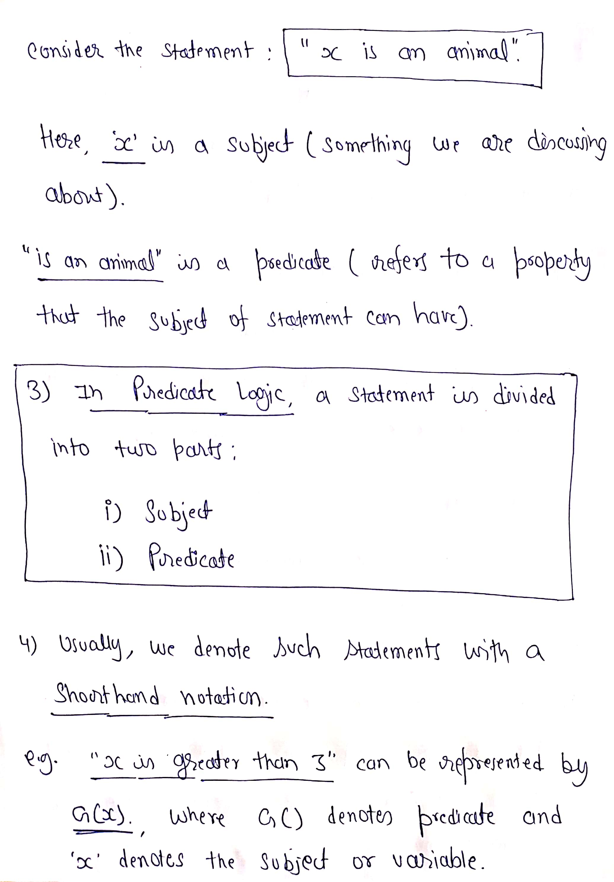

Slide 8
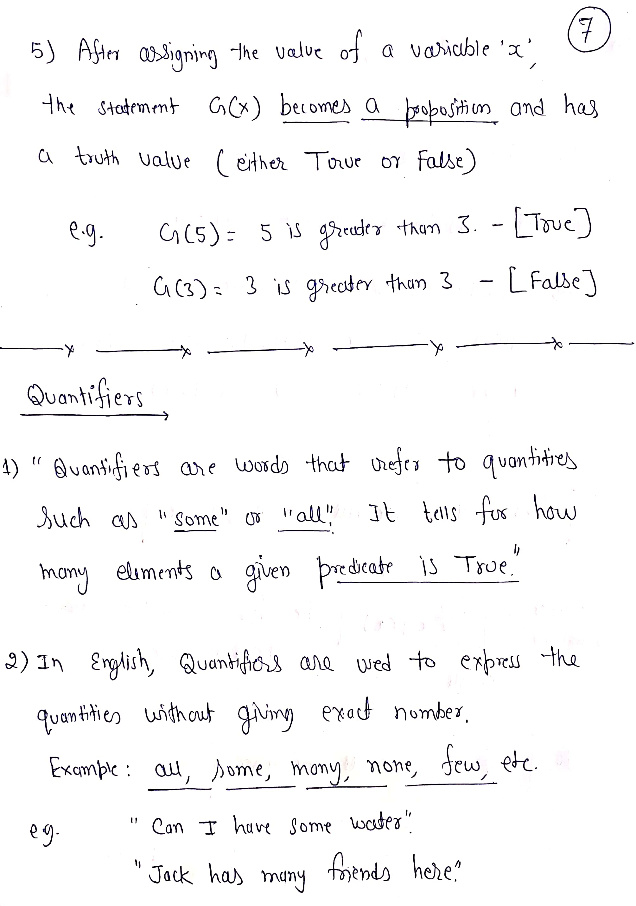

Slide 9
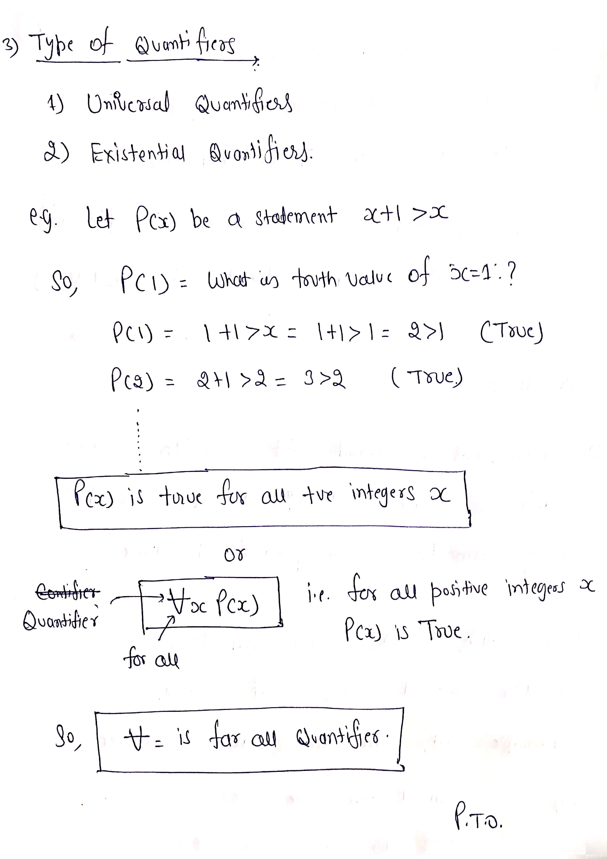

Slide 10
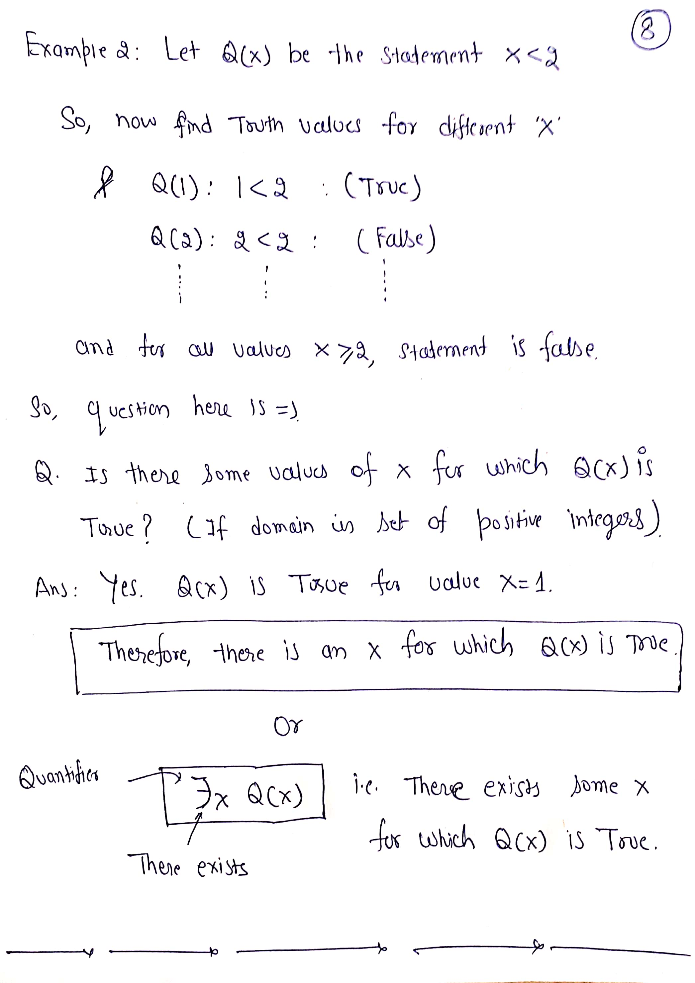

Slide 11
First Order Predicate Logic (FOPL)
FOPL was developed to extend the expressiveness of Propositional logic.
Propositional logic works fine in situations where the result is either true or false. However, there are many real life situations that cannot be treated this way.
Predicate logic is the area of logic that deals with
predicates and quantifiers
Predicate – refers to a property that the subject of a statement can have
E.G. “x is greater than 3”
x → is the subject and
“is greater than 3” → is the predicate

Slide 12
Limitations of Propositional Logic
The propositional logic has its limitations that you cannot deal properly with general statements of the form
“All men are mortal”
You can not derive from the conjunction of this and “Socrates is a man” that “Socrates is mortal”
Example:
If All men are mortal = P
Socrates is a Man = Q
Socrates is mortal = R
Then (P & Q) → R is not valid

Slide 13
Syntax of FOPL
Connectives
Quantifiers
Constants
Variables
Predicates
Functions

Slide 14
Syntax of FOPL
Connectives: There are five connective symbols
~ : not or negation
& : and or conjuction
∨ : or or inclusive disjunction
→ : implication
↔ : equivalence or if and only if
Quantifiers: There are two quantifier symbols are
∃ : existential quantification
Example: ∃x means there exist x
∀ : universal quantification
Example: ∀x means for all x

Slide 15
Syntax of FOPL...
Constants: constants are fixed-values terms that belong to a given domain of discourse. They are denoted by numbers, words and small letter.
Variables: variables are terms that can assume different values over a given domain.

Slide 16
Syntax of FOPL...
Predicates: a predicate is defined as a relation that binds two atoms together. Ex: Rabbit likes carrots, is represented as
LIKES(rabit, carrots)
Here LIKES is a predicate that links two atoms “rabbit“ and “carrots“
Functions: it is also possible to have a function as an argument, e.g. “ Ravi’s father is Rani's father" is represented as-
FATHER(father(Ravi), Rani)
Here FATHER is a predicate and father(Ravi) is a function to
indicate Ravi’s father.

Slide 17
Syntax of FOPL...
Constants, variables, and functions are referred to as terms.
Predicates are referred to as atomic formulas or atoms.
When we want to refer to an atom or its negation, we often use the word literal.
In addition to above symbols, left and right parentheses , square brackets, braces, and the period are used for punctuation in symbolic representation.

Slide 18
Translating English to FOPL
Bhaskar likes aeroplanes.
Ravi‟s father is rani‟s
father.
Plato is a man
Ram likes mango.
Sima is a girl.
Rose is red.
John owns gold
Ram is taller than mohan
My name is khan
Apple is fruit.

Slide 19
Translating English to FOPL
Ram is male.
Tuna is fish.
Dashrath is ram‟s father.
Kush is son of ram.
Kaushaliya is wife of Dashrath.
Clinton is tall.
There is a white alligator.
All kings are person.
Nobody loves john.
Every one has a father.

Slide 20
Translating English to FOPL
Bhaskar likes aeroplanes.
Ravi‟s father is rani‟s
father.
Plato is a man.
Ram likes mango.
Sima is a girl.
Rose is red.
John owns gold.
Ram is taller than mohan.
My name is khan.
Apple is fruit.
Likes (bhaskar, aeroplanes). Father(father(ravi), rani )).
Man (plato). Likes(ram, mango). Girl(sima) .
Red (rose). Owns(john, gold). Taller(ram, mohan).
Name (khan) or Name(my, khan) Fruit(apple).

Slide 21
Translating English to FOPL
Ram is male.
Tuna is fish.
Dashrath is ram's father.
Kush is son of ram.
Kaushaliya is wife of Dashrath.
Clinton is tall.
There is a white alligator.
All kings are person.
Nobody loves john.
Every one has a father.
Male (ram). Fish (tuna).
Father (dashrath, ram). Son(kush, ram).
Wife(kaushaliya, dashrath).
Tall(clinton). Alligator (white).
∀x: Kings(x) → Person(x).
∀x: ¬Loves(x, john).
∀x: ∃y: Father(y,x)

Slide 22
Translate into predicate logic
Marcus was a man.
Marcus was a Pompeian.
All Pompeians were Romans.
Caesar was a ruler.
All Romans were either loyal to Caesar or hated him.
Everyone is loyal to someone.
People only try to assassinate rulers they aren't loyal to.
Marcus tried to assassinate Caesar.
All men are people.

Slide 23
Solution
Marcus was a man.
Man(Marcus).
Marcus was a Pompeian.
Pompeian(marcus)
All Pompeian were Romans.
∀x: Pompeian(x) → Roman(x)
Caesar was a ruler.
Ruler(Caesar)
All Romans were either loyal to Caesar or hated him.
∀x: Roman(x) → LoyalTo(x,Caesar) ∨ Hate(x,Caesar)

Slide 24
Solution
Everyone is loyal to someone.
∀x: ∃y: LoyalTo(x,y)
People only try to assassinate rulers they aren't loyal to.
∀x: ∀y: Person(x) ^ Ruler(y) ^ TryAssassinate(x,y) →¬LoyalTo(x,y)]
Marcus tried to assassinate Caesar. TryAssassinate(Marcus, Caesar)
All men are people.
∀x: Men(x) → People(x)

Slide 25
Translate into predicate logic
Hari likes all kind of food.
Bananas are food.
Apples are food.
Anything anyone eats and isn‟t killed by food.
Hari eats everything ram eats.

Slide 26
Solution
∀x: Food(x) → Likes(hari, x).
Food(bananas) .
Food(apples) .
∀x: ∃y: Eats(y,x) ^ ¬Killedby(y,x) →Food(x)
∀x: eats(ram, x) → eats(hari, x) .

Slide 27
Not all students like both Mathematics and Science. In this question, the predicate is "like(x, y)," where x= student, and y= subject. Since there are not all students, so we will use ∀ with negation, so following representation for this: ¬∀ (x) [ student(x) → like(x, Mathematics) ∧ like(x, Science)]

Slide 28
Translating English to FOPL
Every gardener likes the sun.
Not Every gardener likes the sun.
You can fool some of the people all of the time.
You can fool all of the people some of the time.
You can fool all of the people at same time.
You can not fool all of the people all of the time.
Everyone is younger than his father.

Slide 29
Solution
(∀x): gardener(x) => likes(x, Sun)
~((∀x) :gardener(x) => likes(x, Sun))
(∃x):(∀t) :person(x) ^ time(t) => can-be-fooled(x, t)
(∀x):(∃t) :person(x) ^ time(t) => can-be-fooled(x ,t)
(∃t):(∀x) :person(x) ^ time(t) => can-be-fooled(x, t)
~((∀x):(∀t): person(x) ^ time(t) => can-be-fooled(x, t))
(∀x) :person(x) => younger(x, father(x))

Slide 30
Translating English to FOPL
All purple mushrooms are poisonous.
No purple mushroom is poisonous.
There are exactly two purple mushrooms.
Clinton is not tall.
X is above Y if X is directly on top of Y or there is a pile of one or more other objects directly on top of one another starting with X and ending with Y.
no one likes everyone

Slide 31
Solution
(∀x): (mushroom(x) ^ purple(x)) => poisonous(x)
~(∃x): purple(x) ^ mushroom(x) ^ poisonous(x)
(∀x): (mushroom(x) ^ purple(x)) => ~poisonous(x)
(∃x):(∃y): mushroom(x) ^ purple(x) ^ mushroom(y) ^ purple(y) ^ ~(x=y) ^(∀z) :(mushroom(z) ^ purple(z)) => ((x=z) v (y=z))
~tall(Clinton)
(∀x):(∀y): above(x,y) <=> (on(x,y) v (∃z) (on(x,z) ^ above(z,y)))
~ (∃x):(∀y):likes(x,y) or (∀x):(∃y):~likes(x,y)

Slide 32
Example of FOPL
Marcus was a man.
Man(Marcus).
Marcus was a Pompeian.
Pompeian(marcus)
All Pompeian were Romans.
∀x: Pompeian(x) → Roman(x)
Caesar was a ruler.
Ruler(Caesar)
All Romans were either loyal to Caesar or hated him.
∀x: Roman(x) → LoyalTo(x,Caesar) ∨ Hate(x,Caesar)

Slide 33
Example of FOPL
Everyone is loyal to someone.
∀x: ∃y: LoyalTo(x,y)
People only try to assassinate rulers they aren't loyal to.
∀x: ∀y: Person(x) ^ Ruler(y) ^ TryAssassinate(x,y) →¬LoyalTo(x,y)]
Marcus tried to assassinate Caesar. TryAssassinate(Marcus, Caesar)
All men are people.
∀x: Men(x) → People(x)

Slide 34
Thank You

